Slide 1
CougHacks 2025
Subtitle is Corbel sentence case
Notes:
Remember to hit the reset button to make sure all the page elements react properly.
There are 20 different layouts that you can choose from.

Slide 2
Background
Situation
Action
Nowadays, security and privacy have become one of the most significant issues in our daily lives.
Many online users online presence is defined by what they are interested in.
Our App allows users another form of staying secure by encoding their passwords as their favorite pictures.
Our App allows you to store your favorite pictures as your passwords.

Slide 3
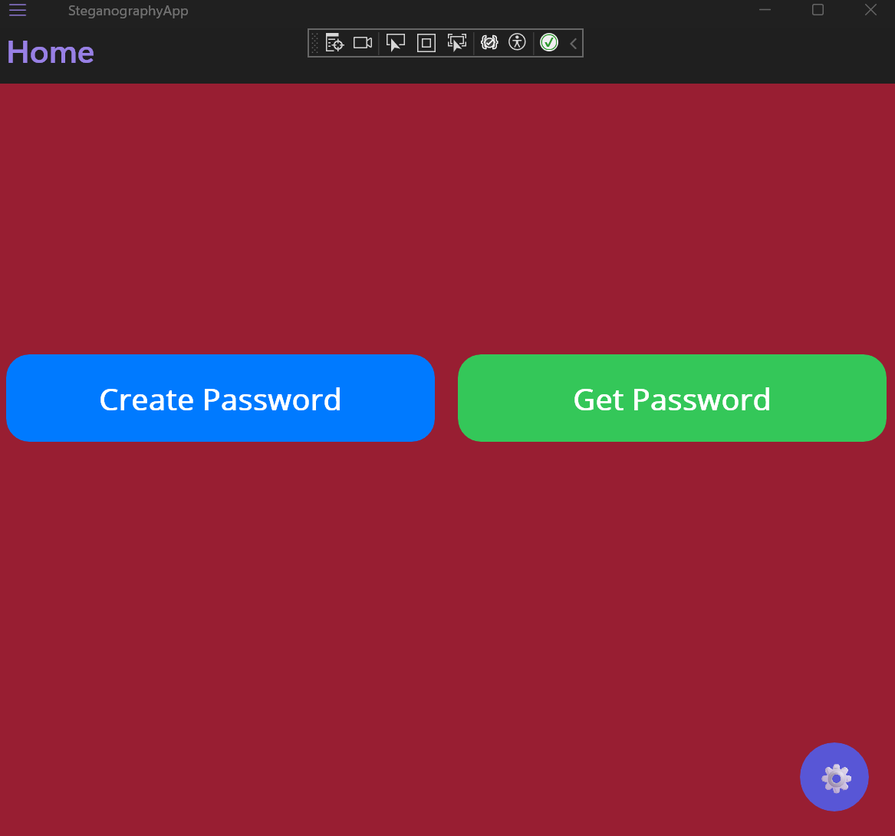
How It Works
Two Modes
Create Password
Choose an image for your password.
Generates a code that is used to retrieve your password.
Get Password
Select your picture password.
Enter the code for your password
Retrieve your password

Slide 4
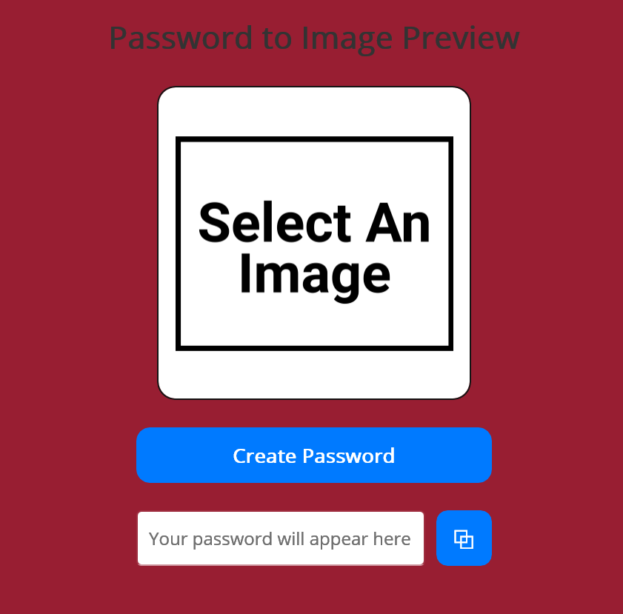
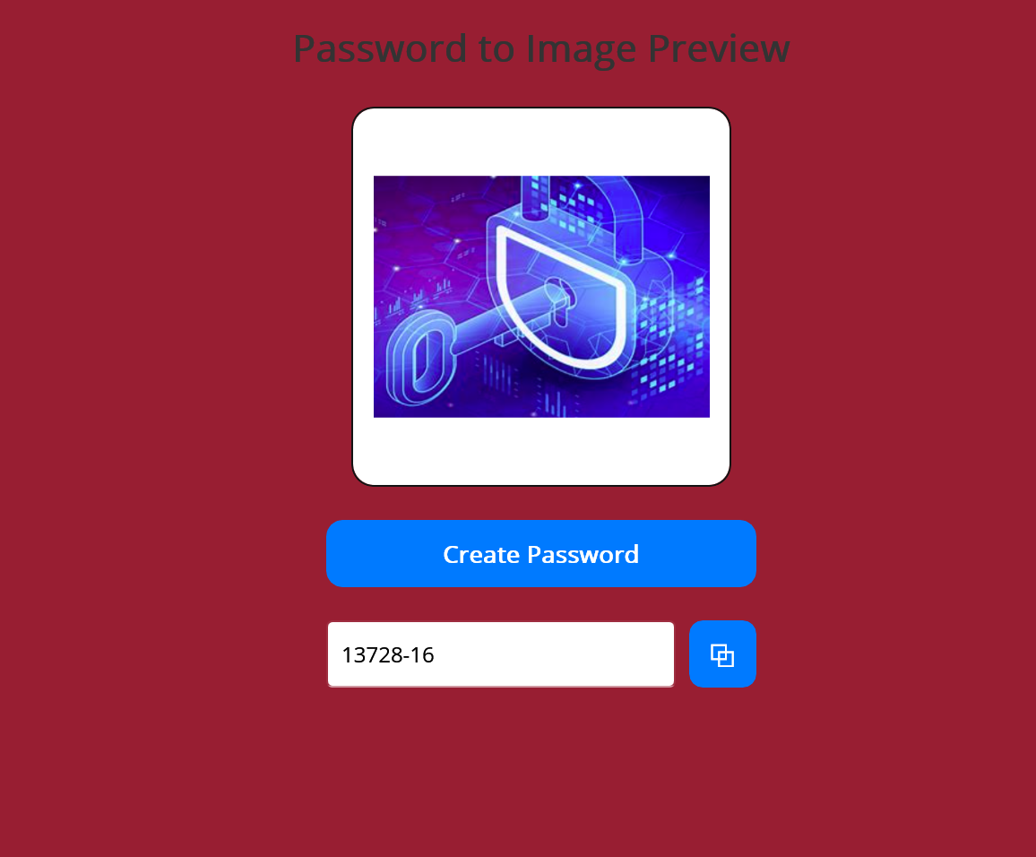
Create Password
Users click “Select An Image”
A preview of the image is presented to the user.
Create Password
A passcode is generated from a random position in the picture and is encoded by the image meta data.
Copy Passcode
This passcode allows you to retrieve your password in “Get Password”

Slide 5
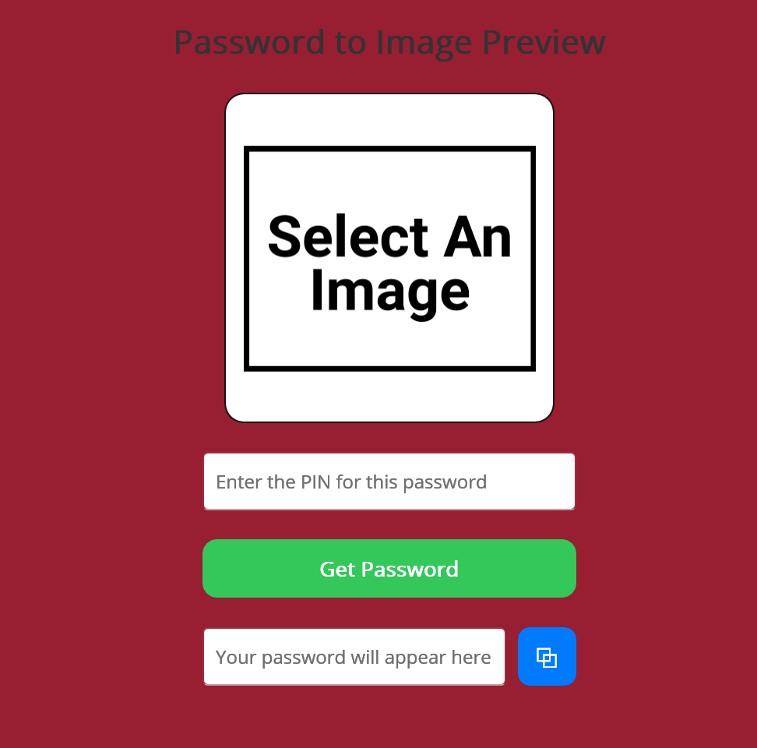
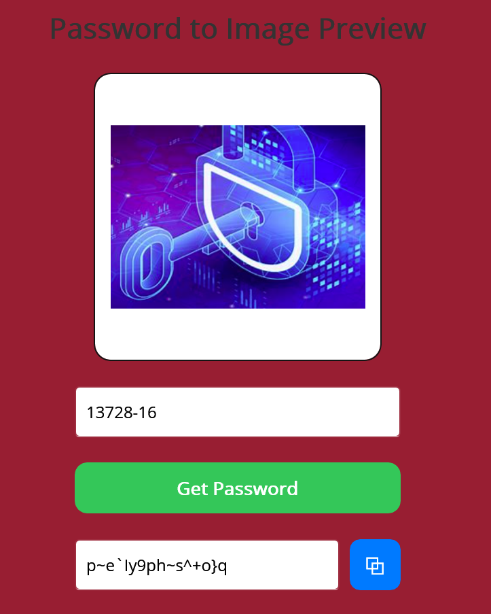
Getting Your Password
Select an image
User chooses picture their password is linked to.
Enter Pin
User enters the pin passcode for their specific Image.
Get Password
Retrieves the users password for that picture and passcode.

Slide 6
How It Works

